Slide 1
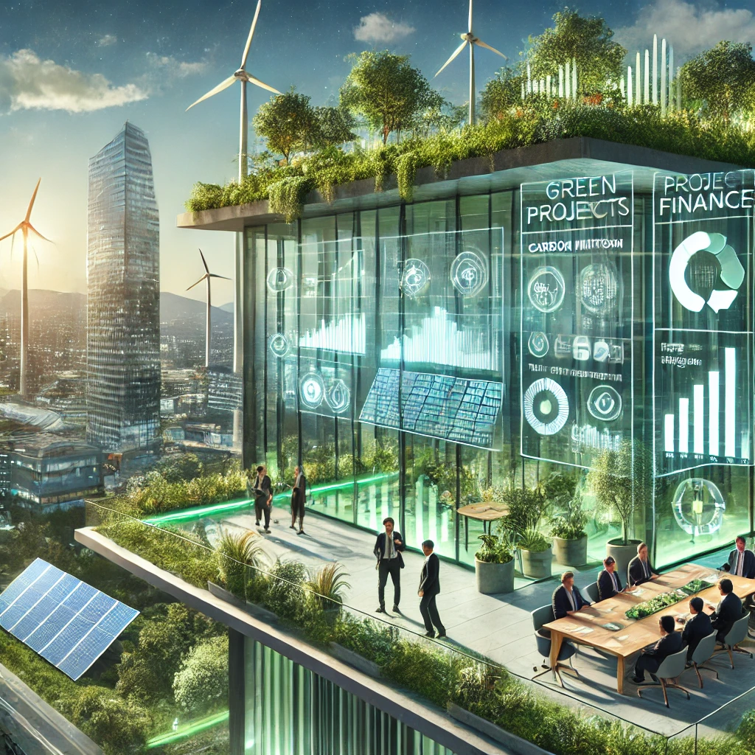
Green Finance Optimization Platform
Team Name: Ctrl + Alt + Del
Sudar Manikandan S – SHA25FF04008
Saroja P – SHA25FF08190
Bharanidharan S – SHA25FF08376
https://github.com/SUDAR2005/IndustryAI

Slide 2
WORKFLOW
Data Collection and Processing:
We planned to create a database considering sustainable projects listed in World Resources Institute.
The dataset consists of project details with financial, environmental, social and governance metrics to evaluate and analyze the sustainability, feasibility, and overall impact of green projects. (To view the metrics click here)
We have planned to use MongoDB for the storage and retrieve it through API with async and retry mechanism for improved efficiency.
b. Project Scoring and Analysis: (ESG)
Environmental impact is calculated from emission data, with CatBoost (Categorical Boosting) chosen for its ability to process sequential data and present it categorically for user clarity.
Social Impact is calculated using Transformers based models and NLP techniques to get insights in this matter
Governance Scoring is determined through a weighted method applied to various compliance metrics.
c. Optimization and Risk Prediction Engine:
Optimization engine aims to increases the ESG impact under constraints and risk tolerance using Linear Programming, Risk adjusted return calculations.
This can be done by using PuLP(Linear Programming Modeler) since it is an optimization problem.
Risk Prediction helps to identify earlier risk in the project from historical data using Hybrid LSTM-Dense Network.

Slide 3
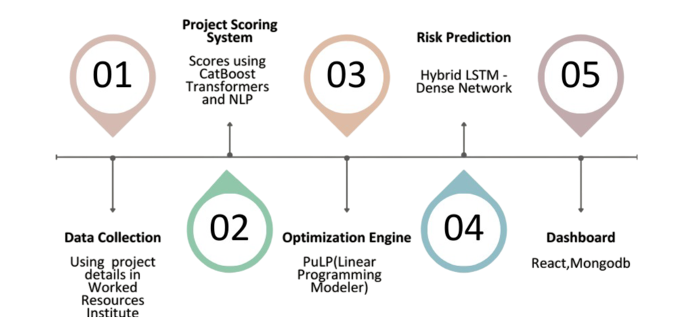
d. Dashboard
React Framework based frontend with Project Overview Panel, Risk Analysis Dashboard and ESG Impact Visualizations.
Fig 1 Flow Diagram
Tech Stack
Tensorflow, Flask, MERN (MongoDB, Express, React JS and Node JS).

